Slide 1
Effective Concurrency Testing for Distributed Systems
Xinhao Yuan, Junfeng Yang
ASPLOS, 2020
2021. 01. 05
Presentation by Lee, Jeyeon
2reenact@dankook.ac.kr

Slide 2
Introduction
Morpheus
Errors Found
Evaluation
Conclusion

Slide 3




1. Introduction
Distributed Systems
Wide deployment, but hard to reason about correctness
Systematic testing, model checking

Slide 4
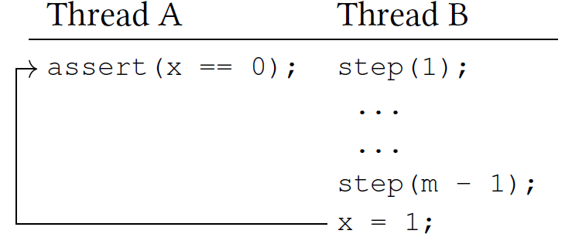
1. Introduction
Distributed System Test
Random walk
randomly pick an operation to execute
outperformed exhaustive searching
poor guarantees
PCT(Probabilistic Concurrency Testing)
bounded number of preemption by changing priorities
some partial order wastes the preemption and weaken the guarantees

Slide 5
1. Introduction
Distributed System Test
POS(Partial Order Sampling)
assigns random priorities to operations
much stronger, probabilistic guarantee
protocol-level errors
Xinhao Yuan, Junfeng Yang, and Ronghui Gu. “Partial order aware concurrency
Sampling”. In Hana Chockler and Georg Weissenbacher, editors,
Computer Aided Verification, pages 317–335, Cham, 2018. Springer
International Publishing.

Slide 6
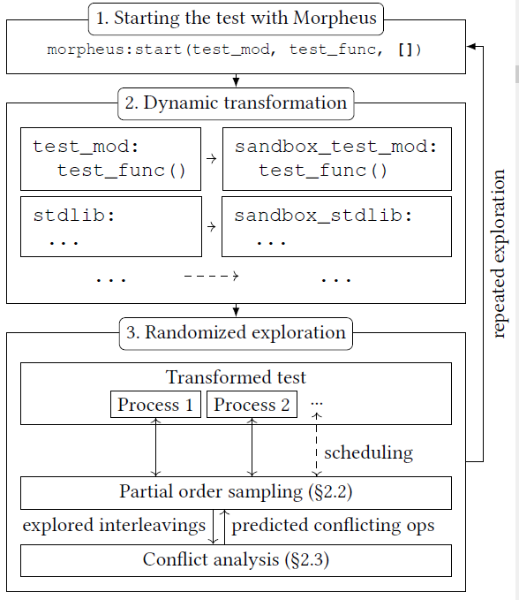
2. Morpheus
Morpheus
Key idea
conflict analysis
handle protocol level errors using Erlang
Workflow
collect available operations
reliably control their interleaving

Slide 7
2. Morpheus
Morpheus
Instrumentation and isolation
deterministic ordering
dynamically transformed prefix
Timing semantics
maintain virtual clock
limited time of deadline

Slide 8
2. Morpheus
Morpheus
Simulating a distributed environment
virtual nodes in a single physical node.
only simulates a fully connected cluster of nodes
Non-Erlang code
Interaction with non-Erlang code

Slide 9
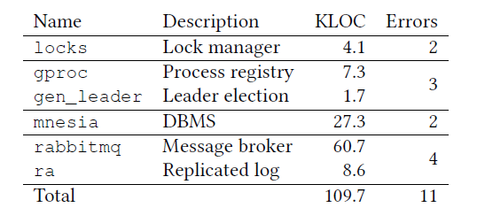
3. Errors Found
Errors in Distributed Systems

Slide 10
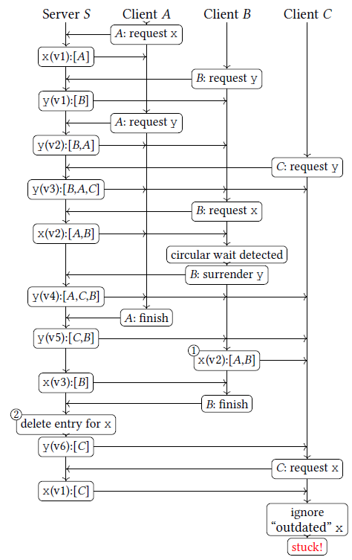
3. Errors Found
Errors in Distributed Systems
deadlocks caused by circular wait

Slide 11
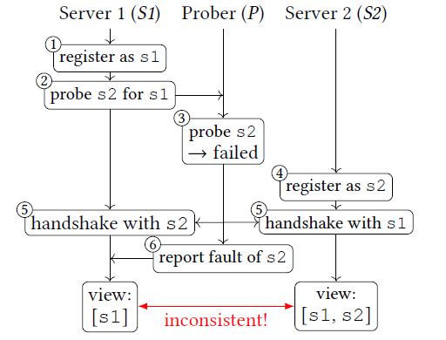
3. Errors Found
Errors in Distributed Systems

Slide 12

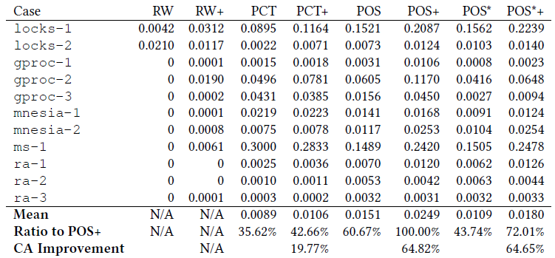
4. Evaluation
# of Trial for Error Detection
Error Detection Performance

Slide 13
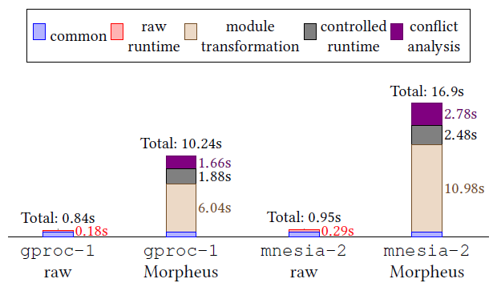
4. Evaluation
Real-time performance of Morpheus

Slide 14
5. Conclusion
Conclusion
Concurrency in distributed systems hard to reason
Morpheus effectively coincide simple root cause of concurrency errors
POS – protocol-level error
~8000 lines Erlang code
Conflict analysis

Slide 15
Effective Concurrency Testing for Distributed Systems
Xinhao Yuan, Junfeng Yang
ASPLOS, 2020
Thank you
2021. 01. 05
Presentation by Lee, Jeyeon
2reenact@dankook.ac.kr

